Slide 1
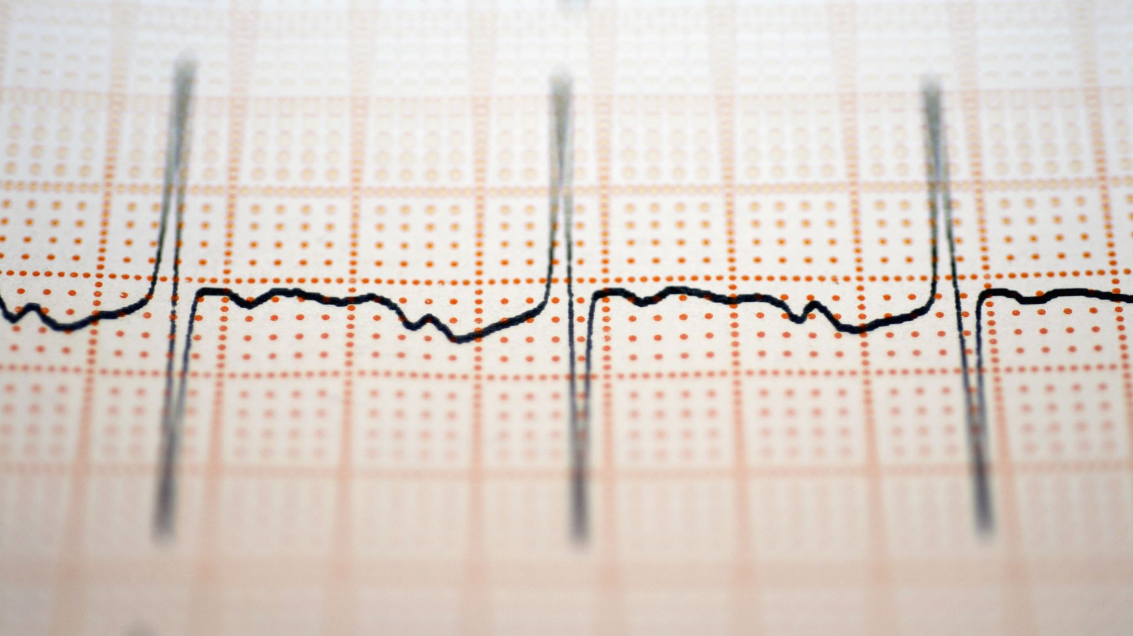
Predicting Heart Failure using Machine Learning(binary classification problems)
Final Project-Update 1
Frank Williams
Adrian Torres
Paige Madison

Slide 2
Project Summary Update
Accomplishments(i.e., Completed Tasks): Defined DS question Can we predict heart failure with the variables in the dataset? Developed working model Linear Regression model | Plans for next update: Split the visualization tasks Answer secondary questions using visuals
Working Well: Ability to load dataset Accuracy metric with test model was assessed | Issues: We may have an excessive number of columns and discerning which are important may be in issue.

Slide 3
Data Origin
The survey data comes from the CDC’s Behavioral Risk Factor Surveillance System and was collected in 2023 and was collected from all 50 states.
The data does not have any Na values, but we did double check.

Slide 4
Steps to Complete
1. Define the Problem
2. Gather Data
3. Data Preprocessing
4. Exploratory Data Analysis (EDA)
5. Feature Selection/Extraction
6. Model Selection
7. Model Training
8. Model Evaluation
9. Iterate and Improve
10. Documentation and Communication
Github changes
Updates:
On 02/17/2024(Duration: 30min)-
We discussed the dataset that we could use, the overall data science question we want to answer, the type of data we want to predict, and the put together a timeline to finish the project.
On 02/19/2024 (Duration: 40min)-
Explored data set further – examined variables and defined questions we want to answer. Shared the Trello board and confirmed each member has access. Set another meeting for next Sunday 3/25/24.
Attendance for Meeting 1:
All were in attendance
Attendance for Meeting 2:
All were in attendance

Slide 5
Secondary Questions for Dataset
What are the leading variables that correlate with candidates who have heart disease?
Of the numeric variables in what range do we start to seeing candidates who do have heart disease?
For non-numeric variables what character strings appearing the most often with candidates who do have heart disease?
What are the least common variables that candidates with heart disease have?
What age do we start seeing heart disease more common among candidates?
At what age do we see heart disease become more common for males and females. Does chest pain correlate with heart disease?
Are there any differences in patients that check ups within a year versus those that get check ups past the 5 year mark?
Does race play a role in the frequency of heart attacks? If so, at what age does race play a role?

Slide 6
Current Variables to Focus On
Race
PhysicalHealthDays
MentalHealthDays
AlcoholDrinkers
PhysicalActivities
SleepHours
CovidPos
Age

